Slide 1
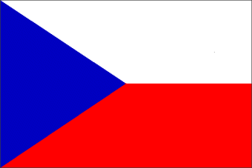
Czech Republic

Slide 2
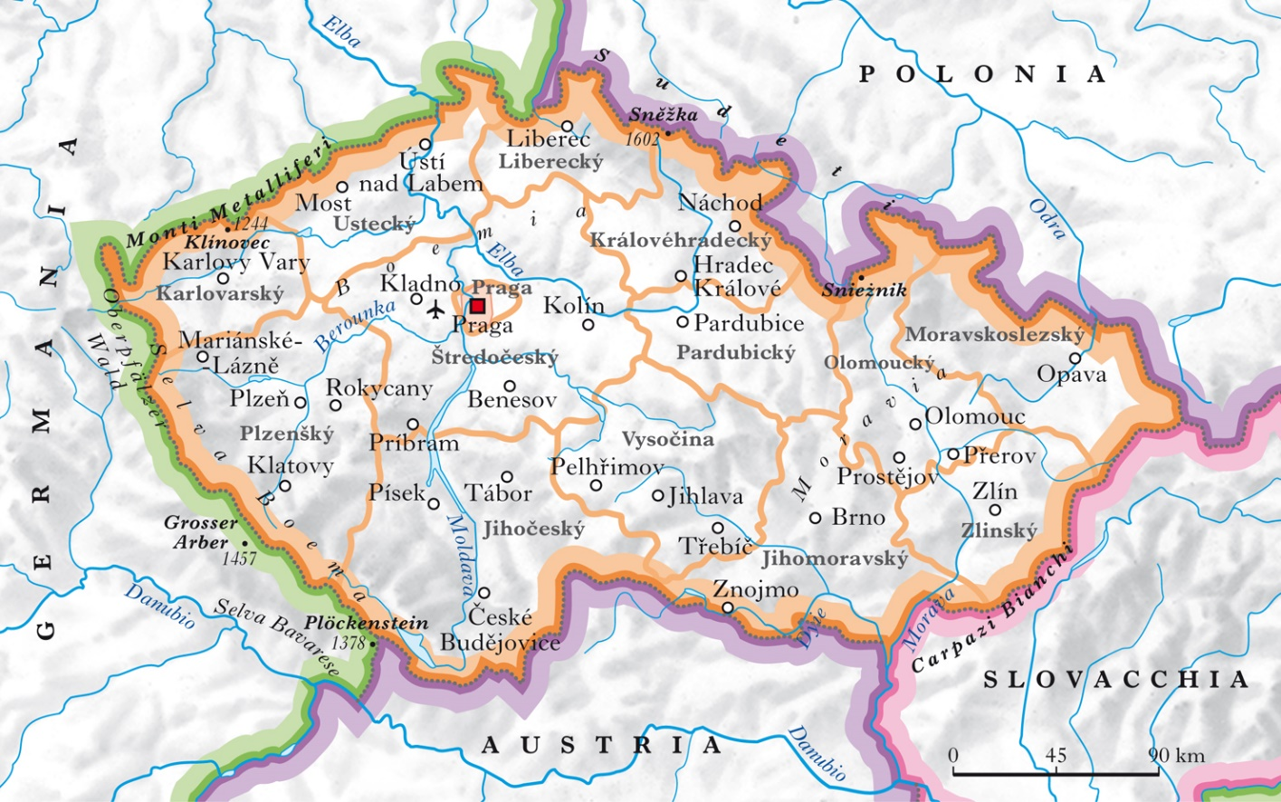
The Czech Republic is a member state of the European Union, located in central Europe.
It borders to the southeast with Slovakia, to the south with Austria, to the west with Germany and to the north with Poland. It is a landlocked state. Its capital is Prague.

Slide 3
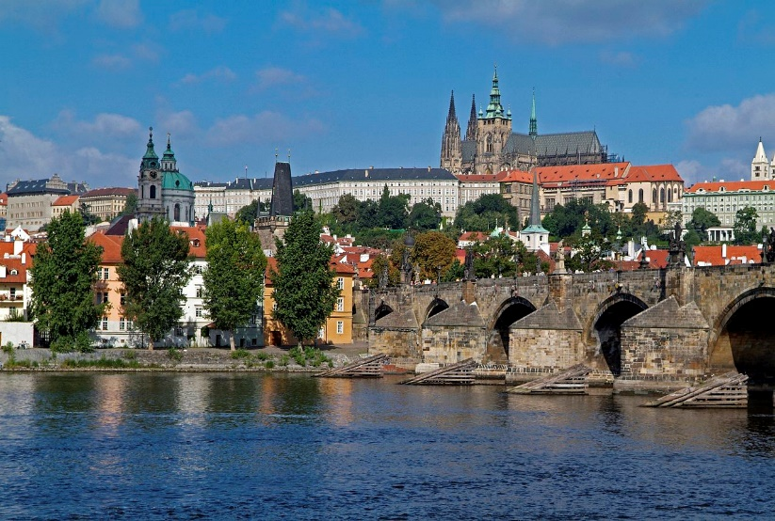
Prague Castle
The Prague Castle stands on one of the nine hills on which the Czech capital develops and was the first inhabited center of the city.
It is currently the official residence of the President of the Czech Republic. Within the complex are: the Cathedral of St. Vitus, the Convent of St. George, the Basilica of St. George, the Golden Lane, the Pinacoteca of the Prague Castle, the Daliborka tower and the Belvedere

Slide 4
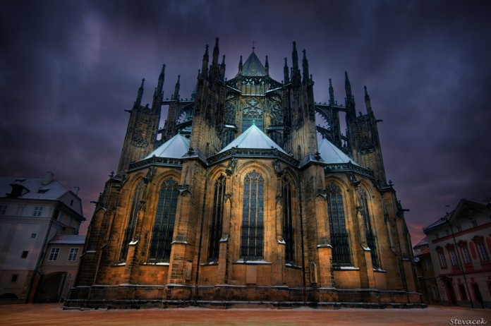
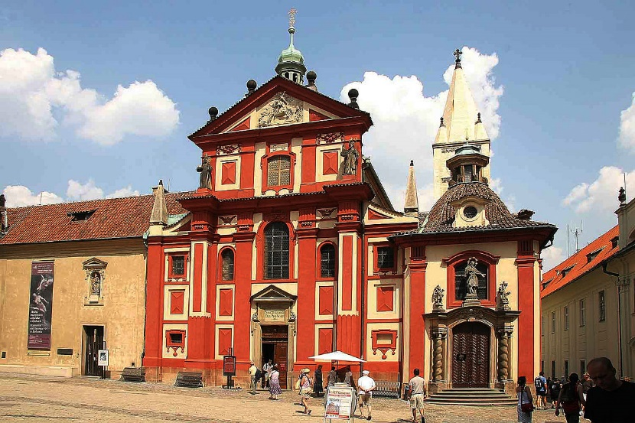
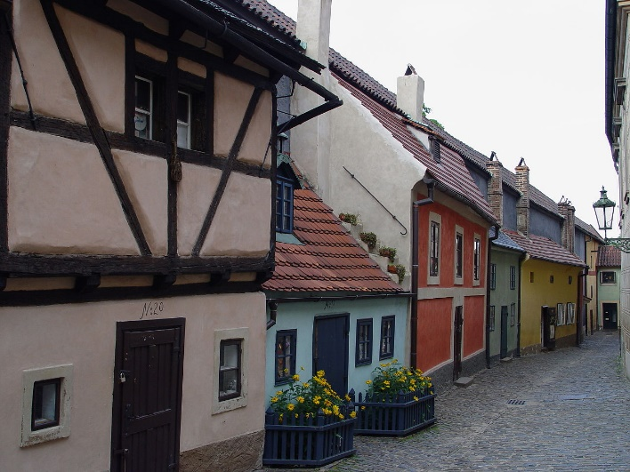
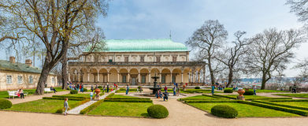
the Cathedral of St. Vitus
The Convent and Basilica of St. George
the Golden Lane
The Belvedere

Slide 5
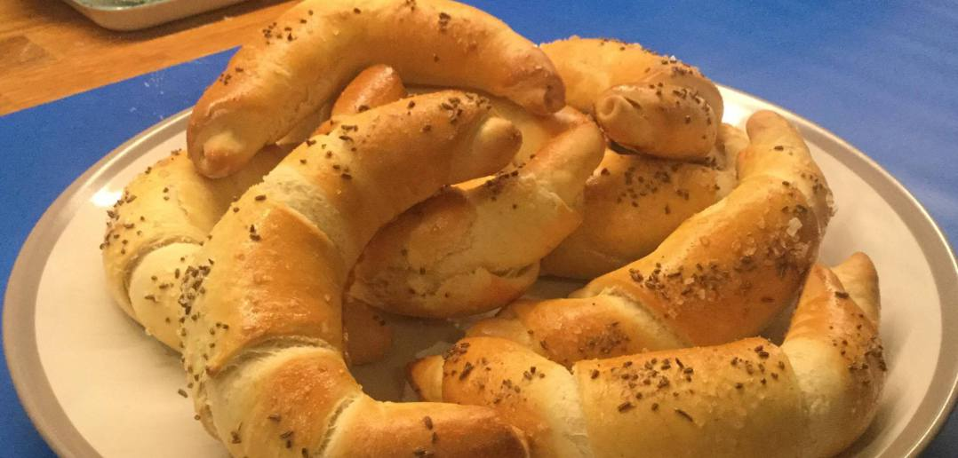
Cuisine
Czech cuisine has recently changed, adhering to a healthier lifestyle; however, traditional Czech recipes are still extremely popular and are quite rich in calories, fat and sugar, in addition to the fact that they prefer particular sauces and condiments, albeit simple.
Rohliky: banana-shaped sandwiches always served as an accompaniment to the main course.

Slide 6
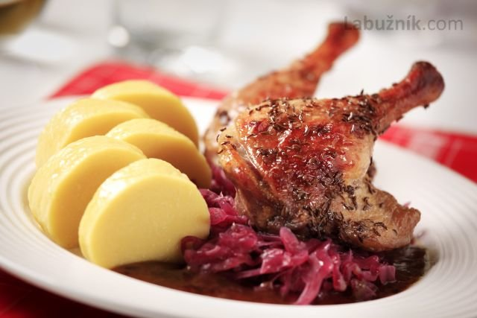
Pecena Kachna (roasted duck, usually accompanied by smoked bacon dumplings and red sauerkraut)

Slide 7
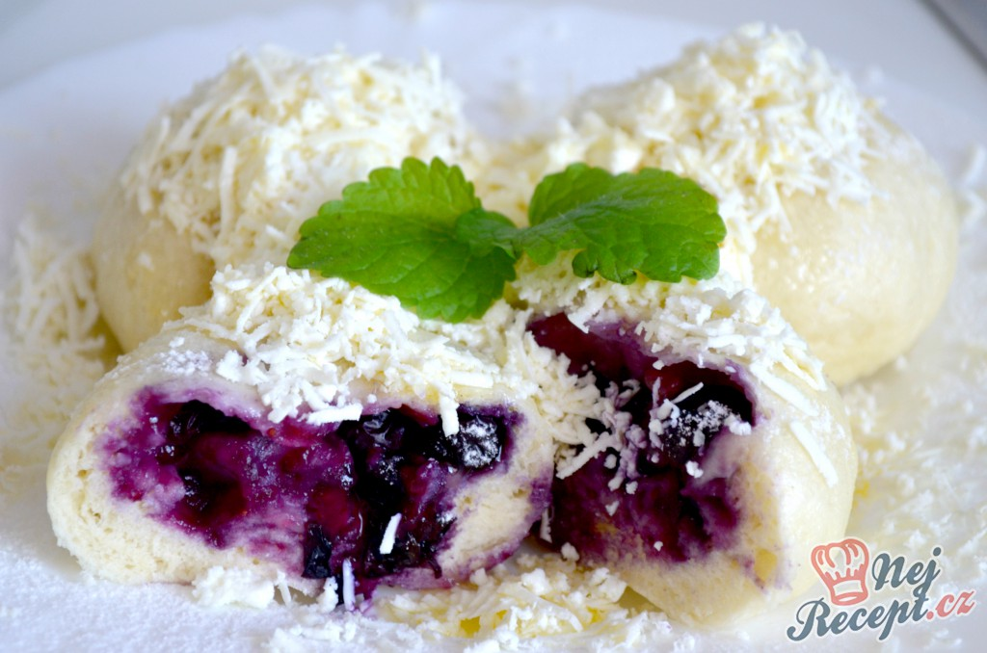
boruvkové knedlíky :blueberry dumplings

Slide 8
Fatto da :
Fatima Ruggiero
Francesca Polucci

