Slide 1
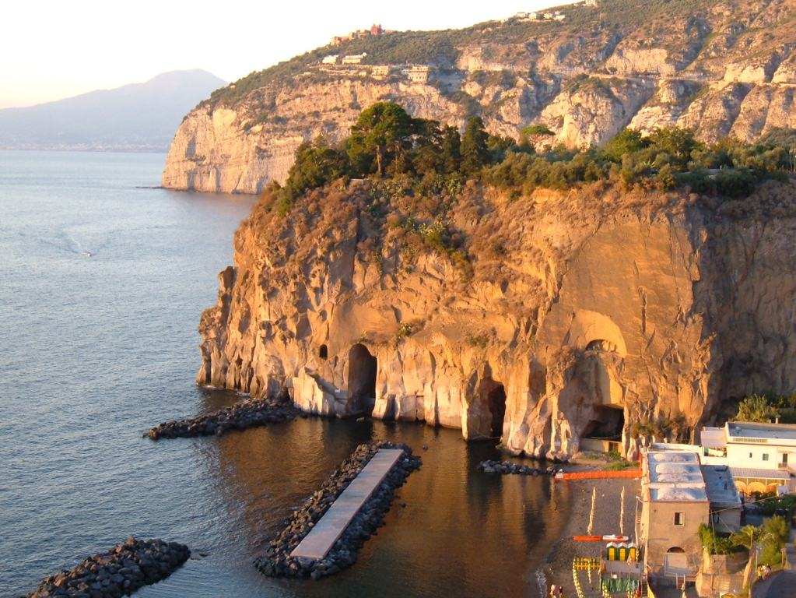
Piano di Sorrento
Presentation of our town

Slide 2
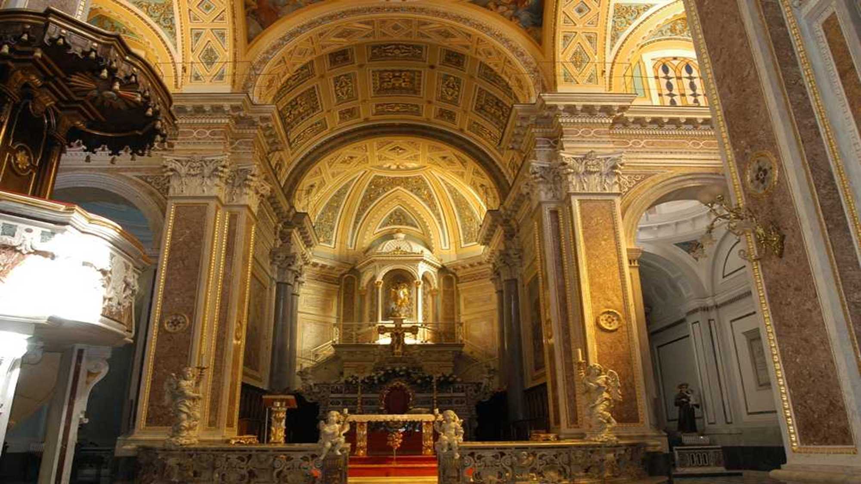
St. Michele’s church
The church was created in the IX century by a bishop.
It is in baroque style

Slide 3
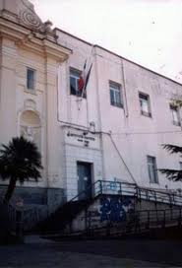
I.T.N. NINO BIXIO
I.T.N. Nino Bixio is a nautical institute situated in Piano di Sorrento.
It’s one of the oldest nautical schools in Europe, as we have evidence that it existed in the XVII Century; in the XIX century it became a «1° class» institution .
It’s a good school for the ones who want to become sea captains.

Slide 4
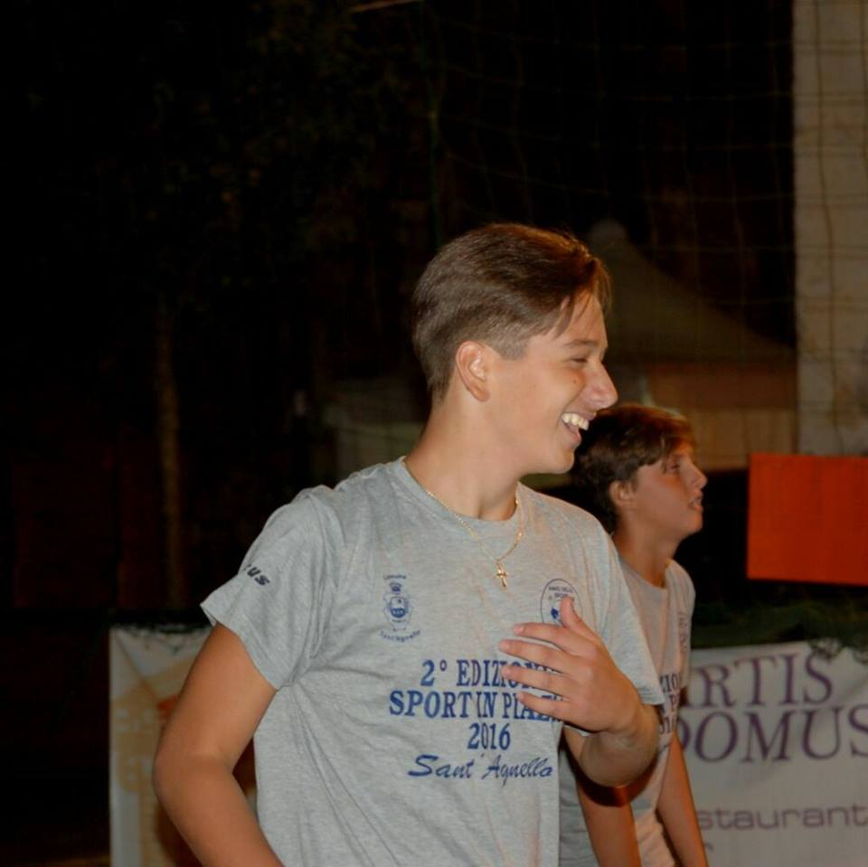
GAETANO RUGGIERO
He is the most important citizen of the town, he represents the future for
this little town because he really loves it.
He studies at Publio Virglio Marone at classical high school.

