Slide 1
VICO EQUENSE
Vico Equense is a European town because it’s cosy and rich of history.

Slide 2
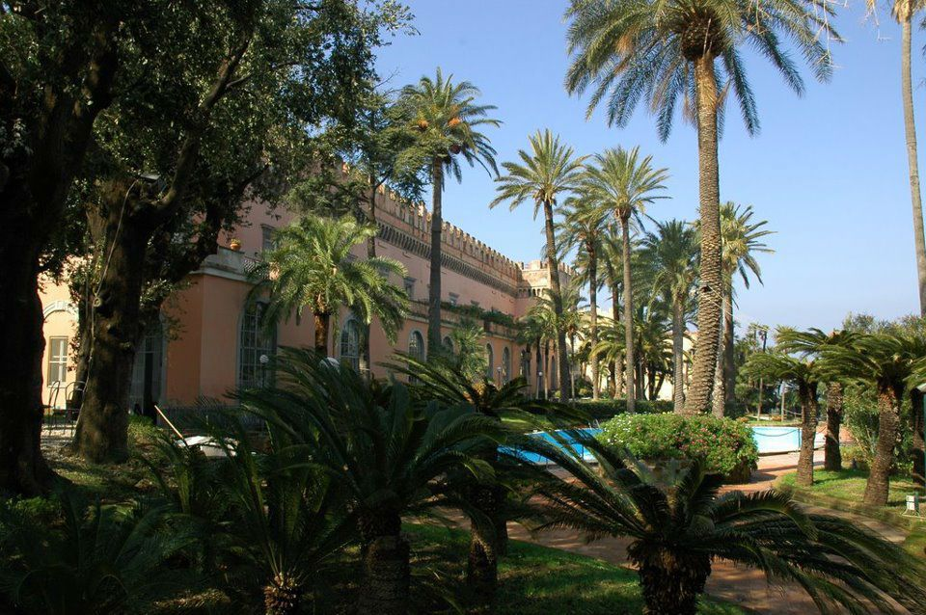
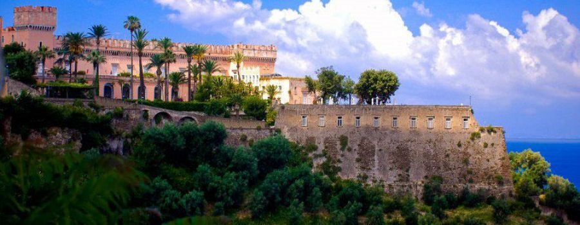
GIUSSO CASTLE
Giusso Castle was built in the XIII century, its name comes from his owners. At the beginning it was a military structure,but now it is used for ceremonies,meetings and for art exhibitions.It’s situated in the historical centre and it’s part of our history. In our opinion it’s one of the most impressive castles of the peninsula.

Slide 3
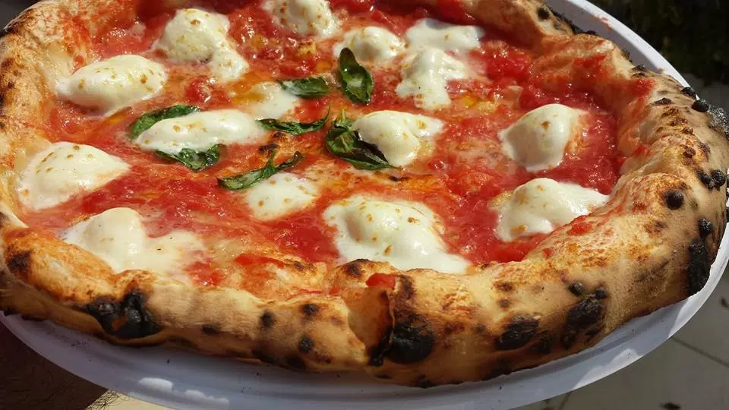
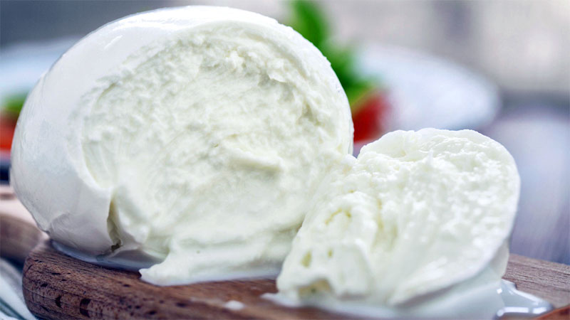
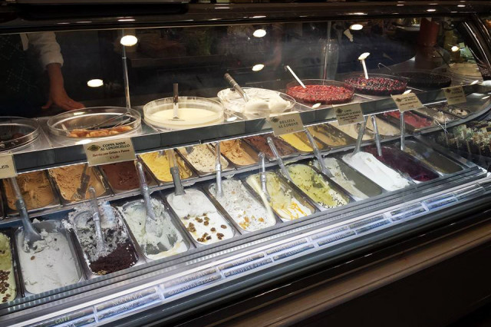
In this town one of the most important things is food,infact many people come here also for food. Some of our specialities are pizza, ice cream and mozzarella.

